Slide 1

Toward Intention Discovery
for Early Malice Detection
in Cryptocurrency
Ling Cheng¹, Feida Zhu^{1,*}, Yong Wang¹, Ruicheng Liang², Huiwen Liu¹
¹School of Computing and Information Systems, Singapore Management University
²School of Management, Hefei University of Technology
The 2023 IEEE Conference on Systems, Man, and Cybernetics (SMC 2023)
Honolulu, Oahu, Hawaii, USA
October 1-4, 2023
Notes:
Today I want to introduce a model called Evolve Path Tracer, which is designed for early detection of malicious address in cryptocurrency.

Slide 2
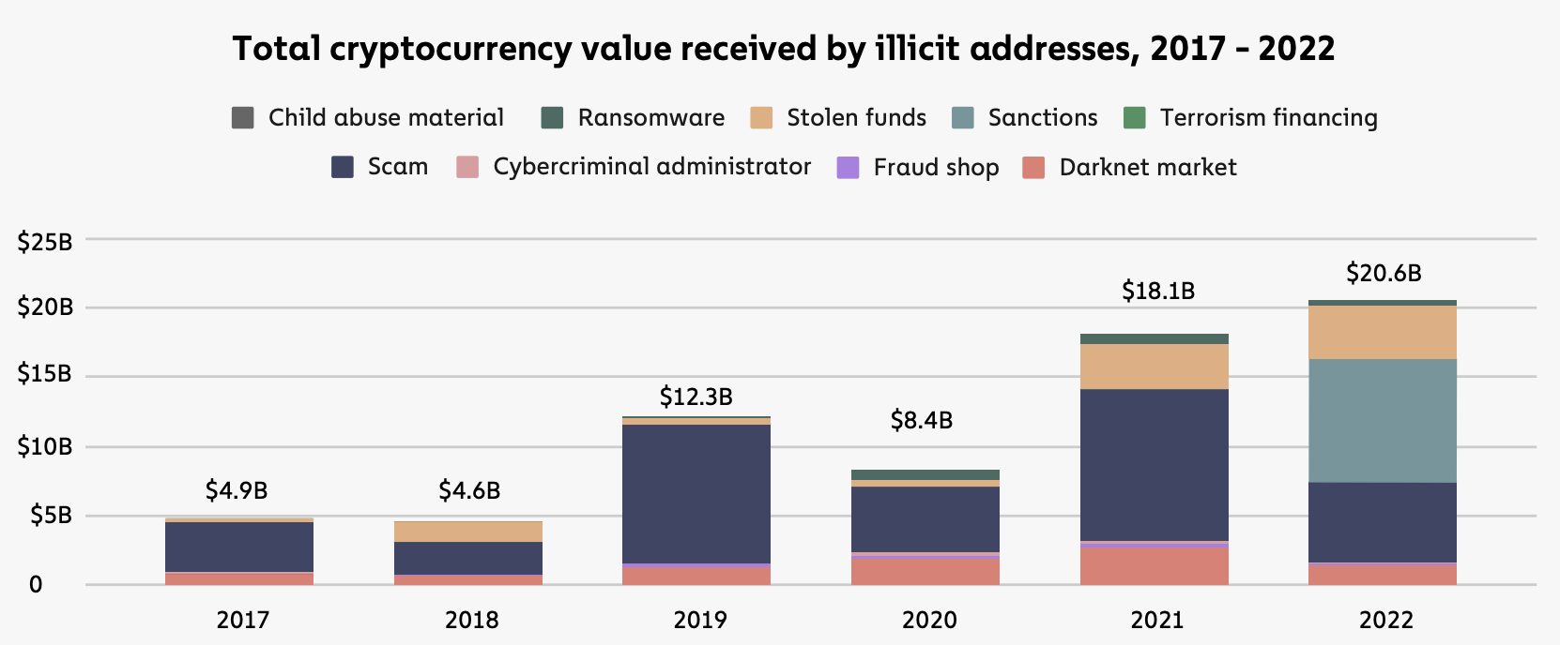
Crypto-Crime Volume is Tremendous
Notes:
Okay. Think about that. If you are a trader or an employee in a cryptocurrency exchange company.
And one day you read a report. you found that despite the market downturn in the last year.
The volume of illicit activity asset still hit its all time high at $20.6 billion,

Slide 3
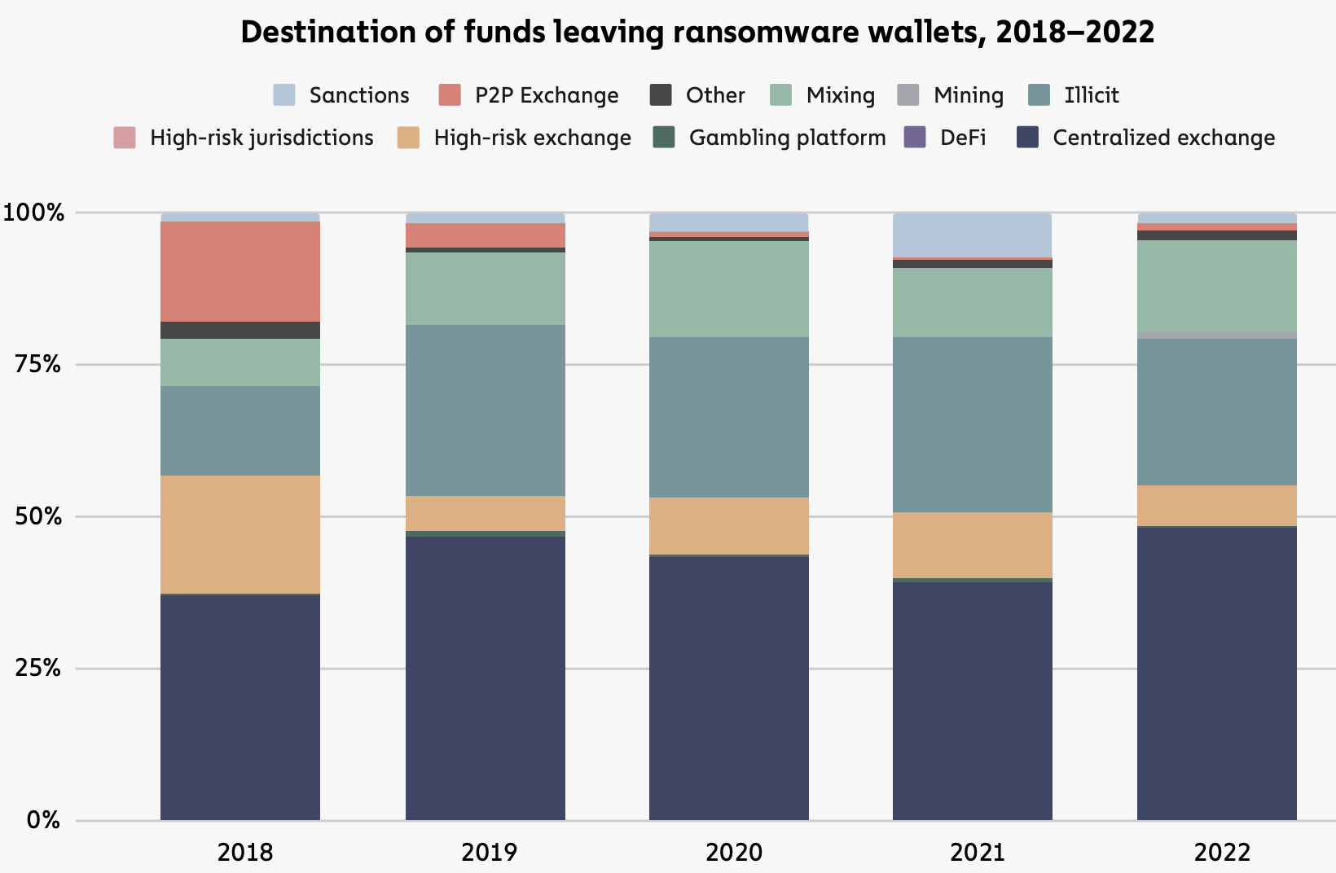
Destination of Illicit Asset
Notes:
and you go on, you found most of this asset are flowing into the centralized exchanges.
So, certainly, you will tell your boss or manager that
we have to build or at least to buy a detection system
to tell us whether the incoming transactions or assets are related to the illicit activities or not, right?

Slide 4
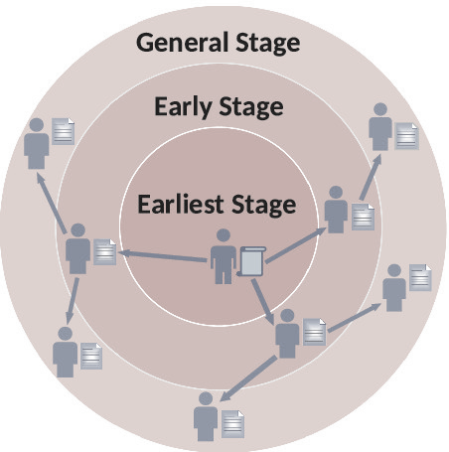
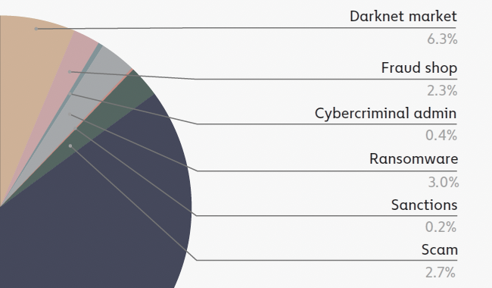

Early
Detection
Malice Type
Versatile
Interpretable
Prediction
Ideal Model
Most malice last for a short duration and cause damage if not be detected in the early stage.
Malice types are constantly evolving. Manually-engineered features for a specific type cannot be generalized to others.
Investors need to tell real creditable projects from frauds. Current models can hardly offer insights for their predictions.
Notes:
For an ideal detection model,
here we propose three critical requirements.
Namely early detection, malice type versatile and free from shadow account.

Slide 5
Outline
Current Challenges
Notes:
These requirements are essentially the challenges for the current method.

Slide 6
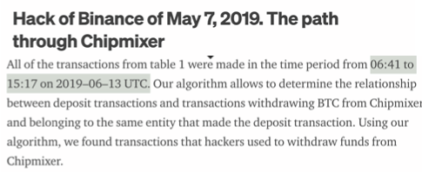
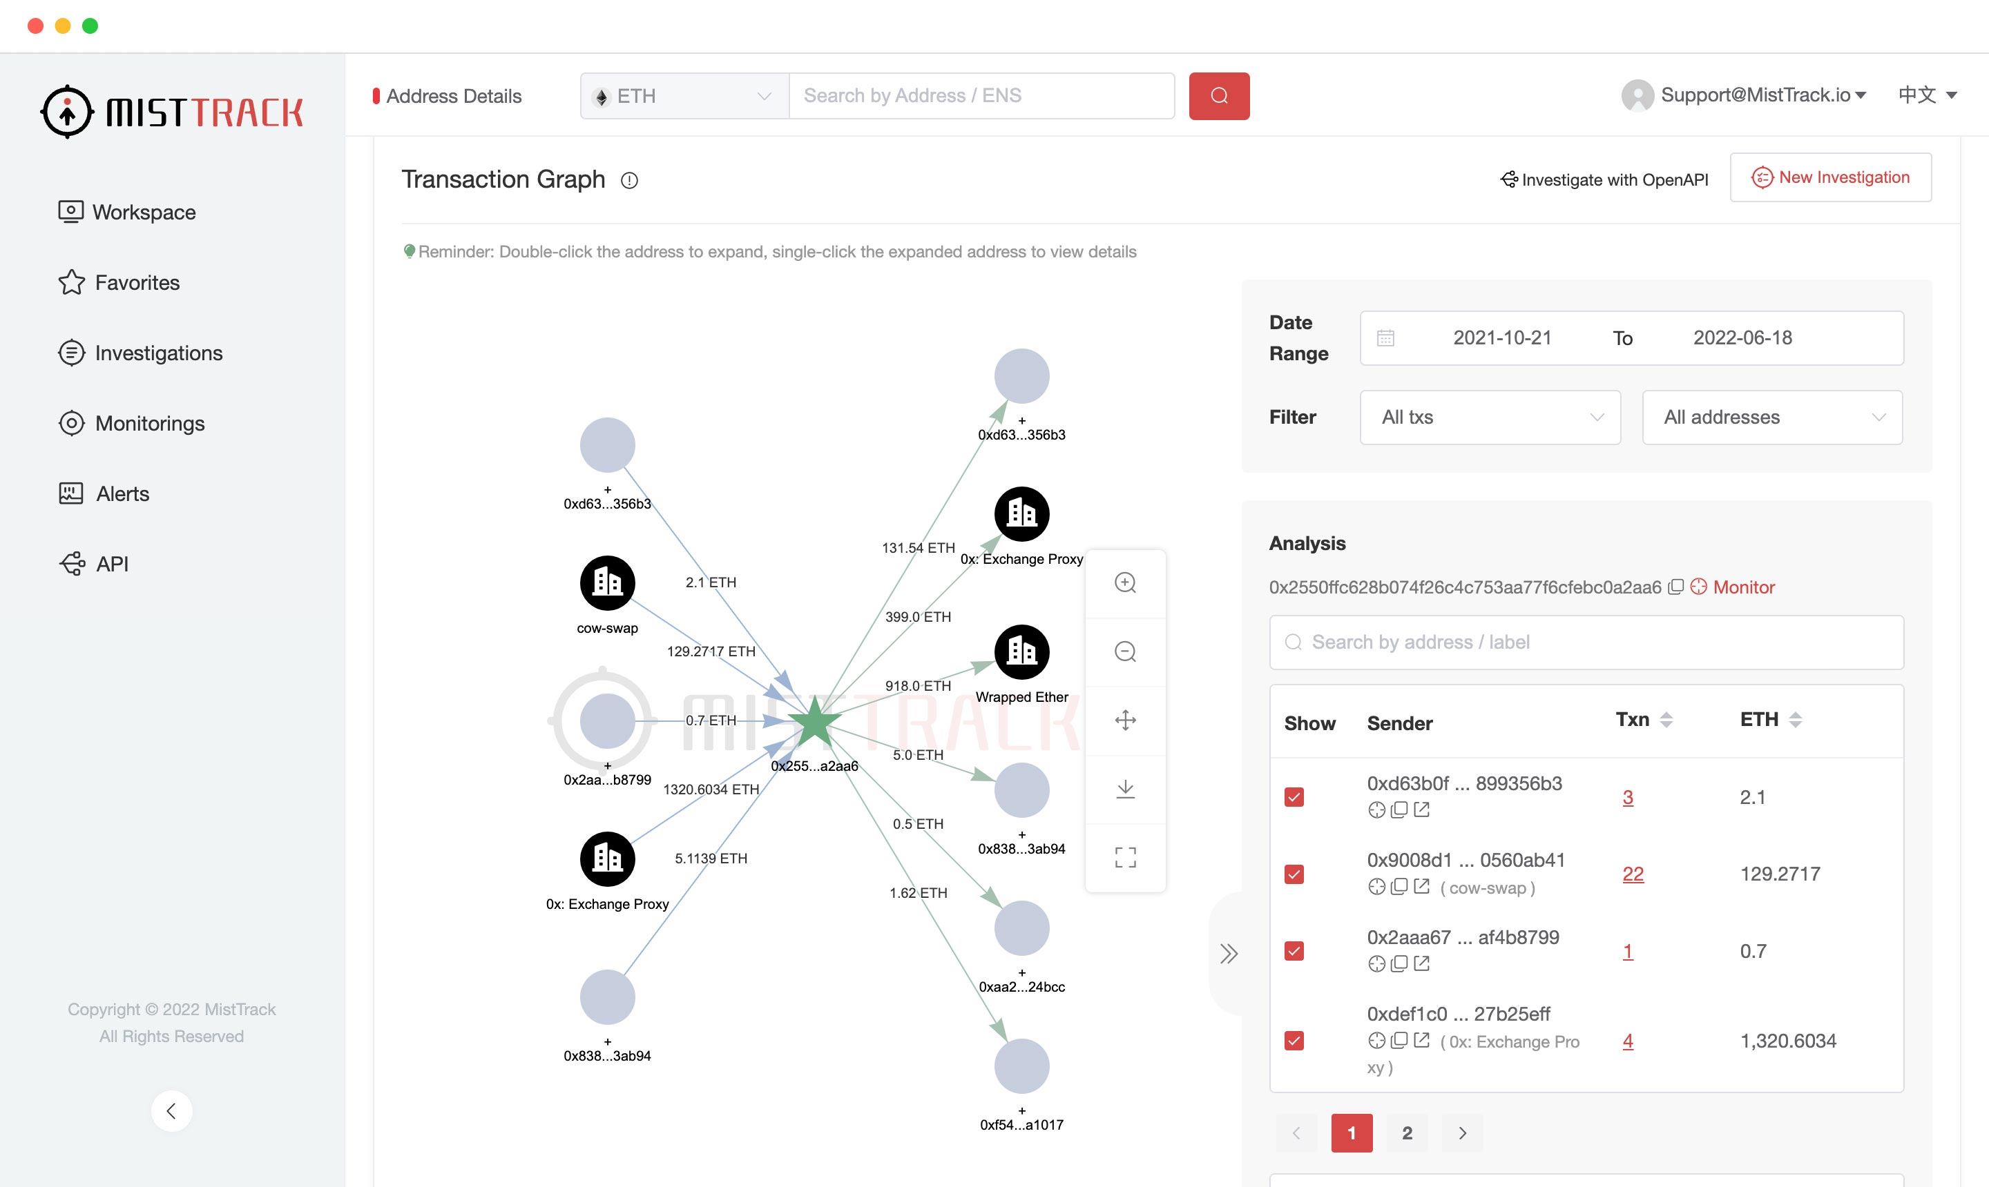
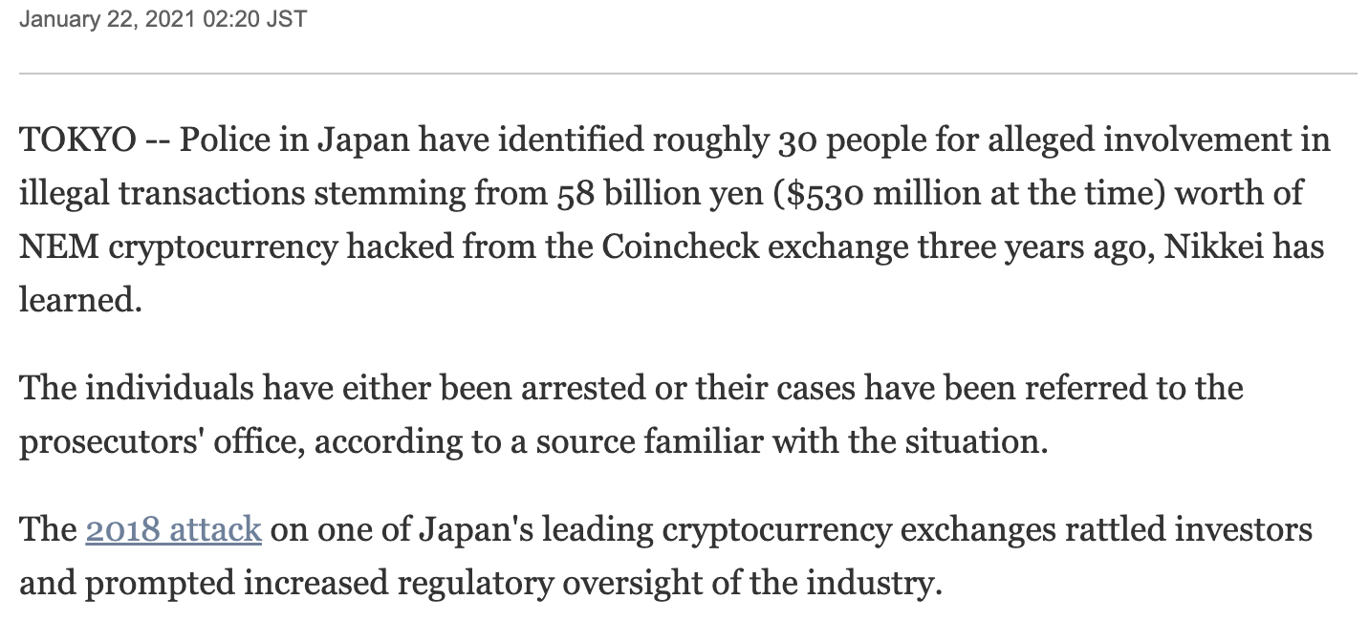
Current Challenges
Ineffective For Early Detection
Jan 22, 2021
(Limited Info / Scalability) Issues for GNN
Jan 27, 2018
Notes:
For the requirement of early detection, as we can see from these examples.
Most of these methods only give the prediction and the detailed analysis after one month.
So it will be too late to redeem the victim's asset back. Right?
The reason is that most of them are based on address transaction graphs.
And this kind of graph as we can see from this example, even though we select a relative long time span,
the address transaction graph is still a little bit primitive, right?

Slide 7
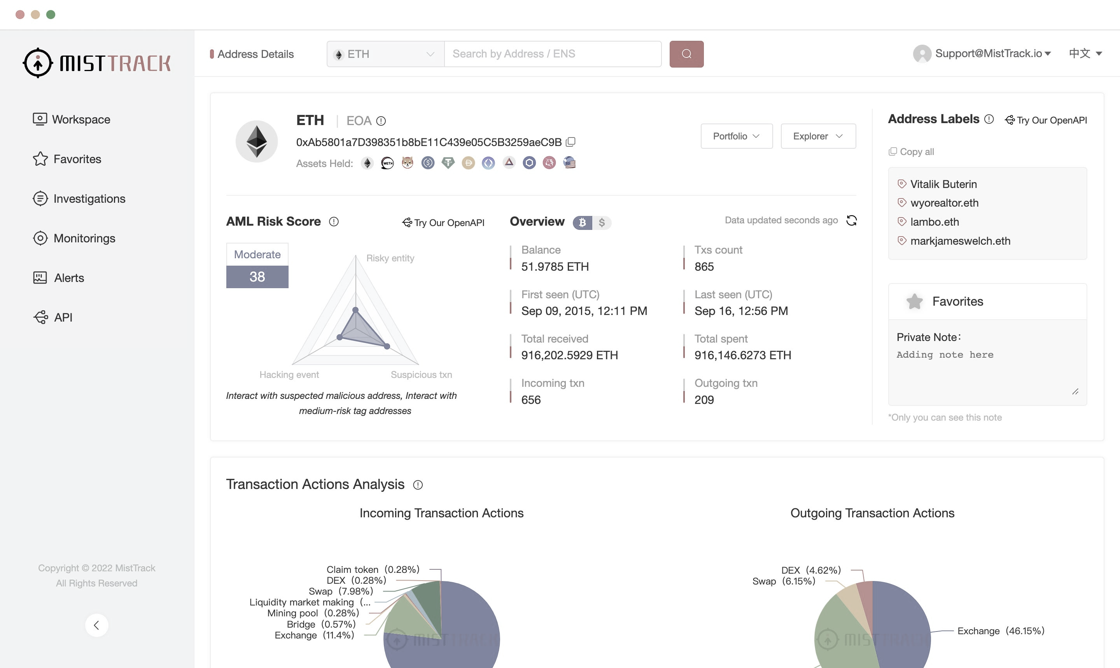
Current Challenges
Lack of Versatility
Most are based on interaction
analysis with specific entities
Notes:
For the requirement of versatility, most of current methods are designed for a specific illicit activity.
For example, this system is only built for Money Laundering detection.
Its analysis is based on interaction analysis with specific entities.
In most cases, this kind of system thus cannot be implemented into other illicit activities detection.

Slide 8

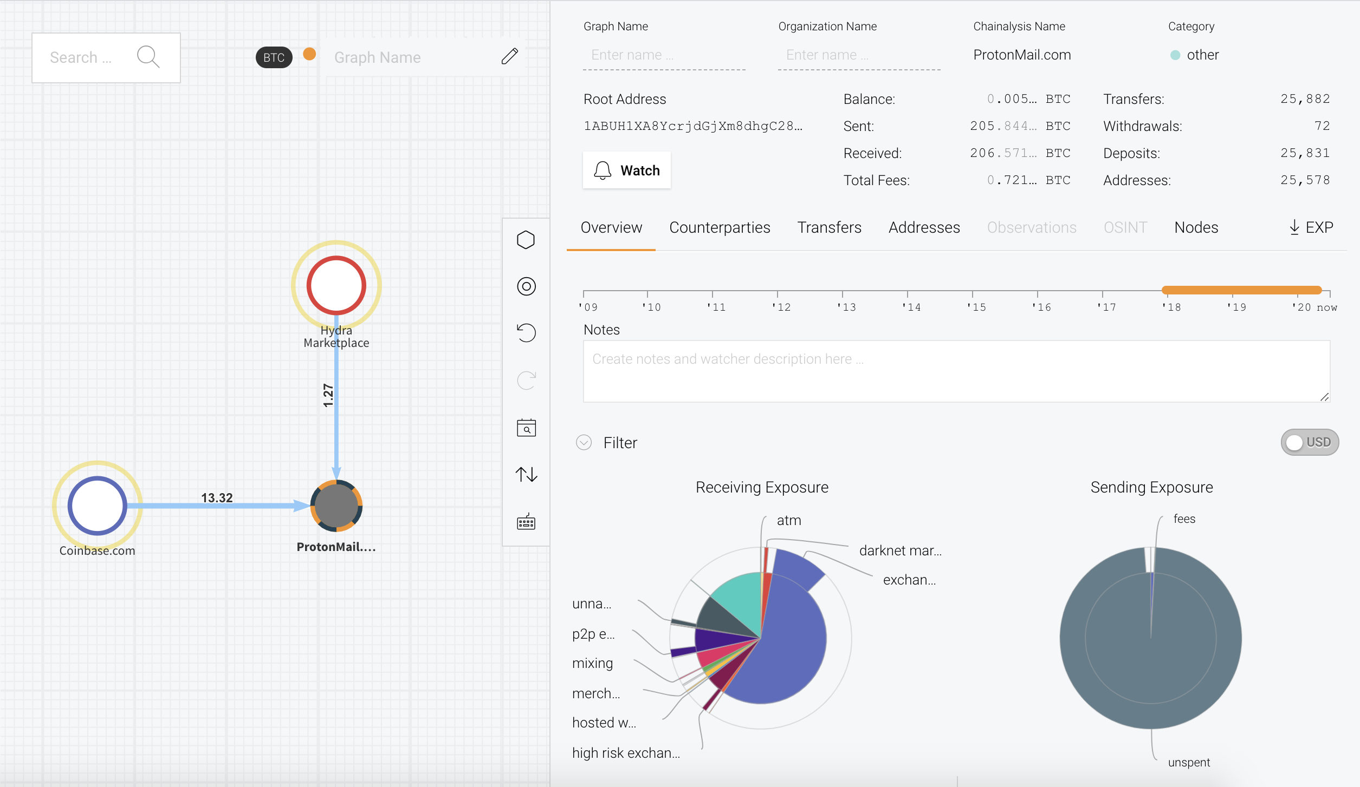
Current Challenges
Lack of Interpretability
Investors need to tell real creditable projects from frauds.
Current models can hardly offer insights for their predictions.
Notes:
Thus, the model should be able to offer insights or explaination for their predictions.
However, current models, as we can see, can hardly

Slide 9
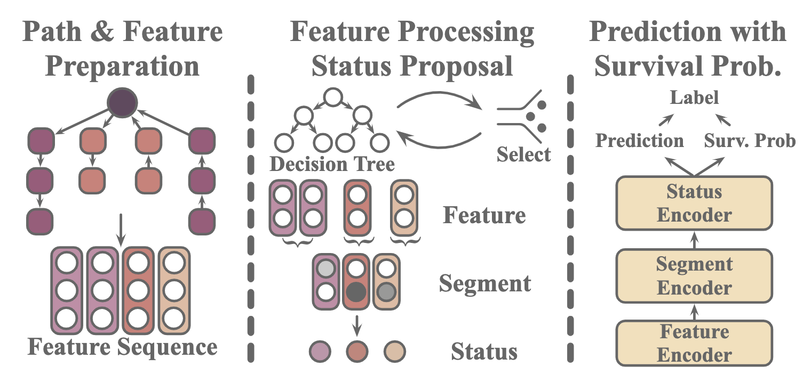
Outline
Notes:
So facing the requirement of interpretability,
We propose our new model Intention Monitor as shown in the figure.
For a given address, at each hour, our model will also build address’s asset transfer path,
Then we prepare the corresponding feature to generate status which will provide certain explaination.
The we predict address label at each hour.

Slide 10
Asset Transfer Path

Slide 11
Asset Transfer Path

Slide 12
Outline
Intention Monitor

Slide 13
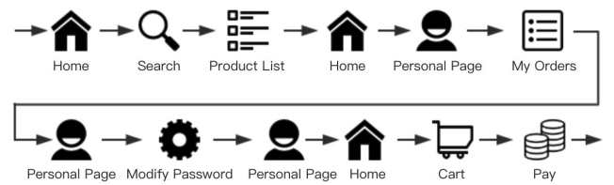
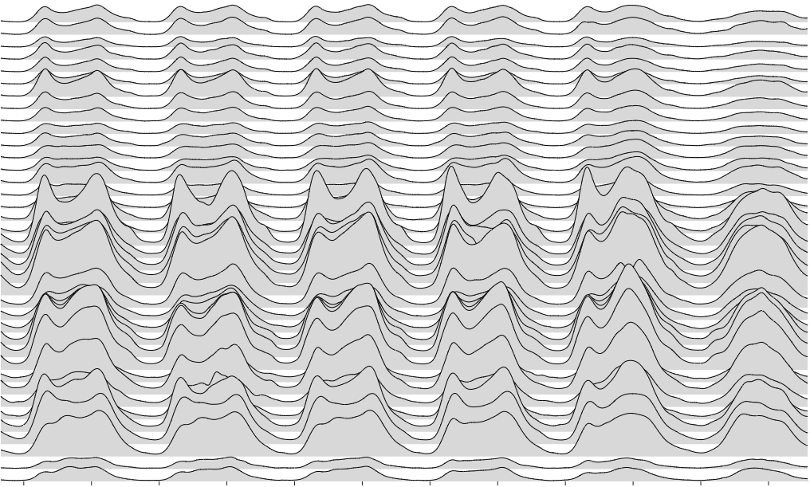
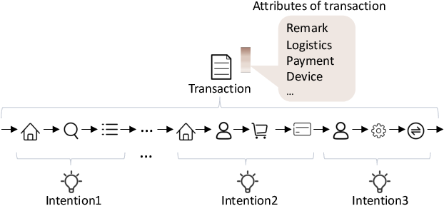
Intention Monitor
State 1
State 2
State 3
State 4
State 5
State 6
Status → Action → Intention
1. Liu, Can, et al. "Fraud transactions detection via behavior tree with local intention calibration." SIGKDD. 2020
2. Liu, Can, et al. "Intention-aware heterogeneous graph attention networks for fraud transactions detection." SIGKDD. 2021
Notes:
In previous works.
They describe intention with action seq.
and seg seq as intention motifs.
So instead of using action to directly represent the intention, we try to use status to profile the intention.

Slide 14
Intention Monitor
Overview of Intention Monitor
How to propose status from temporal feature sequences?
Notes:
not all feature are useful
filter out useless ... with a De Tre
Then we need to seg the whole observation period into segms.
state is a static period, the feature value in this period, thus should also be stable enough,
so we calculate the differential rates
if xxx surpass this threshold,
then we believe, this timestep is the boundary of two statuses.

Slide 15
Intention Monitor
Step-1 Feature Selection & Segmentation
Address N
Address N
Segment
Address 1
Address 1
Seg1
Seg2
Seg3
Notes:
not all feature are useful
filter out useless ... with a De Tre
Then we need to seg the whole observation period into segms.
state is a static period, the feature value in this period, thus should also be stable enough,
so we calculate the differential rates
if xxx surpass this threshold,
then we believe, this timestep is the boundary of two statuses.

Slide 16
Intention Monitor
Step-2 Segment Representation
Address N
Address 1
Address 1
Seg. Vectors
T3
T4
Seg2
(T3-T4)
Address 1
Notes:
at different segments, the importance scores of a certain feature may also be different.
We want to find those most useful features in this segment.

Slide 17
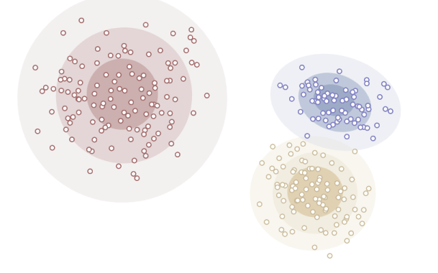
Intention Monitor
Step-3 Status Proposal
Notes:
According to previous calculation,
diff addresses have different segment representations.
but the status we want to generate is a general representation with certain semantic meanings.
These semantics should be general to all addresses.
like, the status of receiving money, spending money, and holding.
So we cluster 。。

Slide 18
Outline
Prediction with
Survival Analysis
Notes:
Now, we get all the necessary data for the prediction.
Speaking abt Surv Ana, it is just like a credit scoring system.
if one tells a lie.

Slide 19
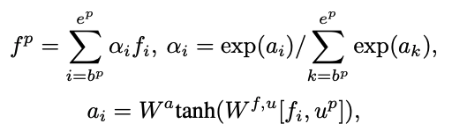
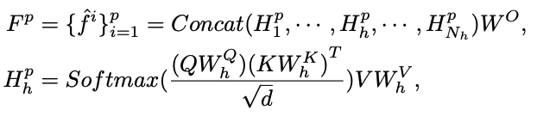
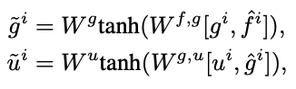
Predictor
Feature Sequence (in hours)

Slide 20
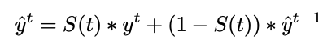
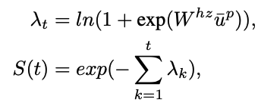
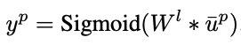
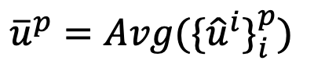
Predictor
$${\overline{u}}^{p}={Avg(\{{\hat{u}}^{i}\}}_{i}^{p})$$
…
Segment Sequence (in segment)
Feature Sequence (in hour)

Slide 21
Outline
Case Analysis
Notes:
To justify the interpretability of our Intention Monitor, we conduct a case study.

Slide 22
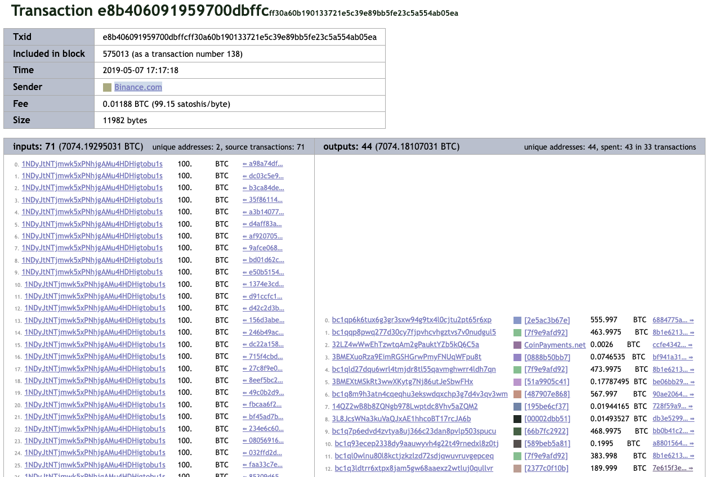
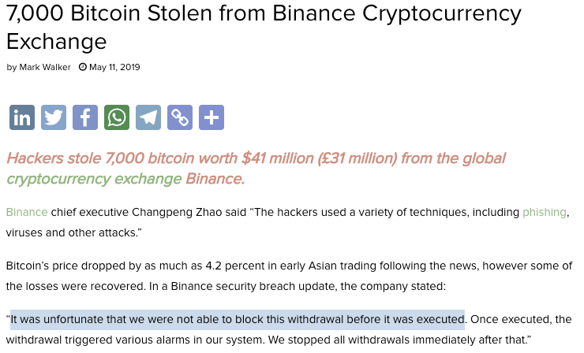
Case Analysis
Case Recap
Notes:
In this case, 7 Thousands BTCs were stolen from Binance, And we quote the words from Binance: “It was unfortunate that we were not able to block this withdrawal before it was excutted”.
Here is the detail of that Hacking transaction,
we select the address which received the highest amount of stolen BTC as the objective.

Slide 23
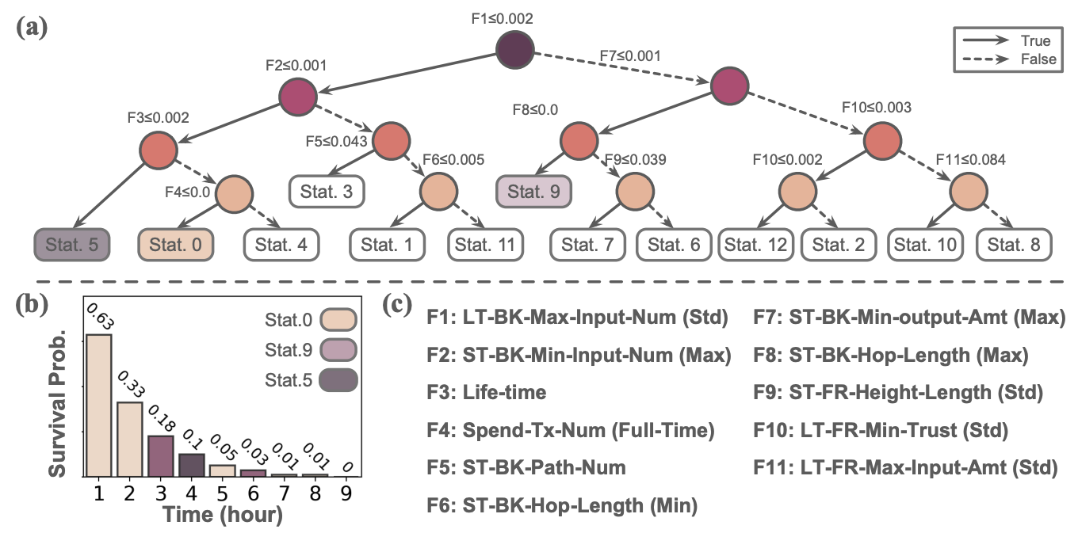
Case Analysis
Sample Address Analysis
[0-0-9-5-0-9-0-0-0]
Notes:
After preprocessing, we get the status sequence of this address.
And we build a decision tree to interpret each status.
We thus can use this decision tree to profile the intention for this address.
For the early detection performance, we can see that, by the end of 9th hour, we can predict the label with 100 percent confident. which is12 hours before transfer out

Slide 24
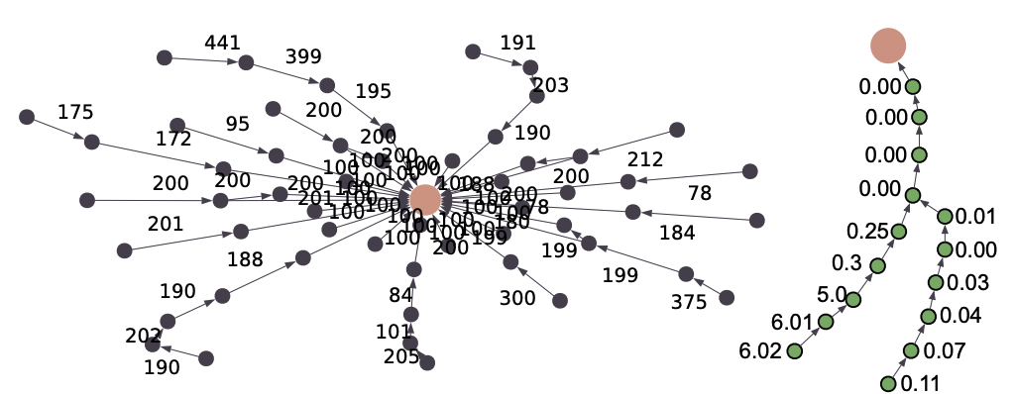
Case Analysis
Sample Address Analysis
Status 0
[0-0-9-5-0-9-0-0-0]
Asset comes from a single source.
No spend transaction.
Status 9
The asset was obtained from a single source through a bunch of transitions.
Each transition “peels” a certain amount off before passing it onto the receiver.
The hacker received 568 BTCs through 71 input TXs with no output.
Status 5
At the 13th hour, it received 0.00008642 BTC.
Still no spending transactions after the initial asset received from a single source at the early beginning.
At the 21st hour, it transferred out all its BTC.
Notes:
so what happened at that time?
At the beginning,
....
---
To understand each status,
I translate the feature value to semantics meaning based on the decision tree shown bf.
and we can see that, the semantics coordinate well with the behavior of this hacker address.
---
Generally, benevolent users will receive btc from a single transactions rather than this scatter center shape.
Also, they don't have to peel certain amount off during the transition.
(click)
And, most addresses receive such large amount will transfer it as soon as possible, or store it as cold wallet.

Slide 25
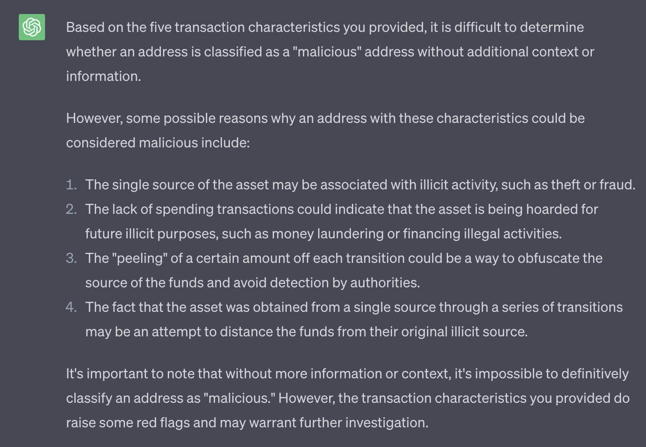
Case Analysis

Slide 26
Conclusion
Early
Detection
Asset
Transfer Path
Intention
Proposal
Illicit early detection is necessary in BTC system.
Asset flow gives more information at an early stage.
Intention motifs can profile suspicious patterns.

Slide 27
Thanks for Listening

